Slide 1
Clyde Bridge Project – making our own Bridge creations!
September 2023

Slide 2
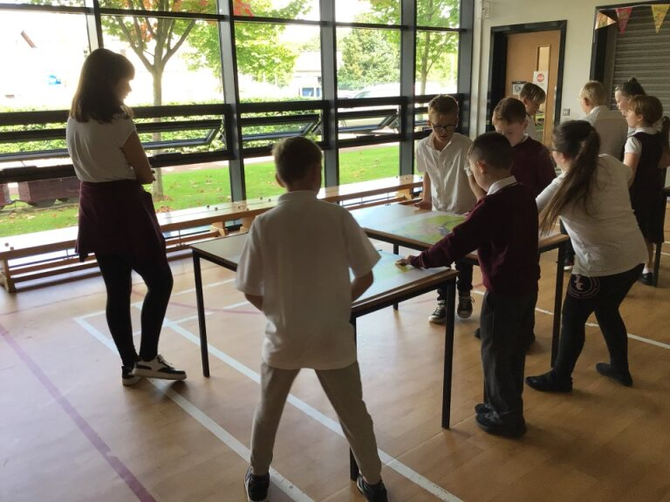

Slide 3
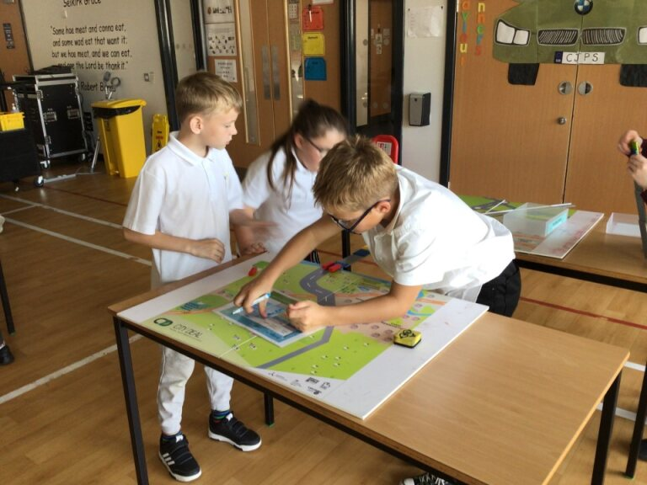

Slide 4
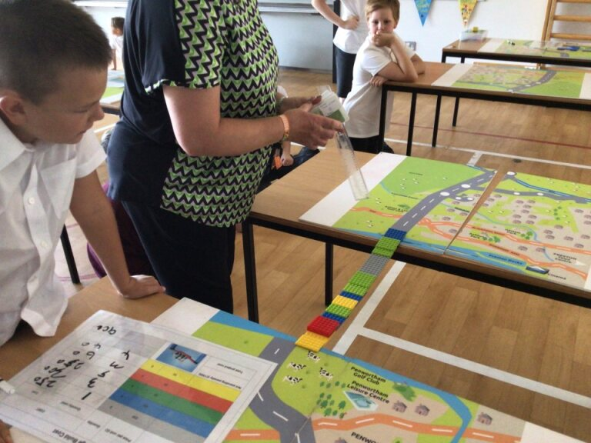

Slide 5
